Slide 1
Drosophila lab-II-2
Supplemental lecture
11-3-16

Slide 2
A closer look at crossing over
Homologous chromosomes are duplicated and paired in a tetrad of chromatids
Crossover can occur between any 2 non-sister chromatids

Slide 3
Crossover is thought to occur at least once in each tetrad during meiosis.
However, the location of the x.o. varies in individual gamets and is only observed if it occurs between genes for which traits are noted to recombine.

Slide 4
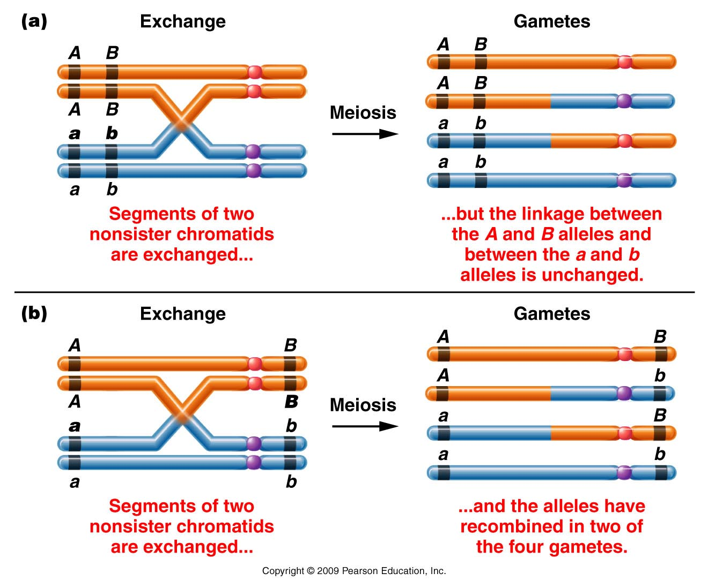
Figure 5.5
Notes:
Figure 5-5 Two examples of a single crossover between two nonsister chromatids and the gametes subsequently produced. In (a) the exchange does not alter the linkage arrangement between the alleles of the two genes, only parental gametes are formed, and the exchange goes undetected. In (b) the exchange separates the alleles, resulting in recombinant gametes, which are detectable.

Slide 5
You would not notice cross over in offspring of this organism if you were studying traits A and B
You would notice cross over in offspring of this organism if you were studying traits A and B
Figure 5.5
Notes:
Figure 5-5 Two examples of a single crossover between two nonsister chromatids and the gametes subsequently produced. In (a) the exchange does not alter the linkage arrangement between the alleles of the two genes, only parental gametes are formed, and the exchange goes undetected. In (b) the exchange separates the alleles, resulting in recombinant gametes, which are detectable.

Slide 6
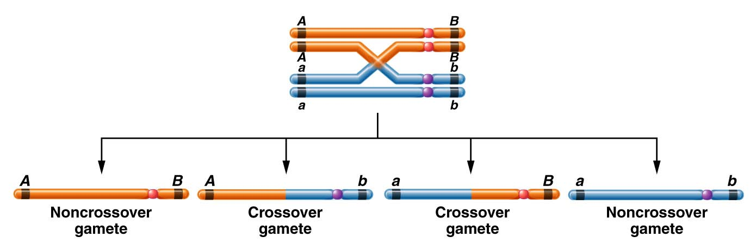
Important concept---for each crossover event, only half of the gametes will show new combinations of alleles.
Figure 5.6
Notes:
Figure 5-6 The consequences of a single exchange between two nonsister chromatids occurring in the tetrad stage. Two noncrossover (parental) and two crossover (recombinant) gametes are produced.

Slide 7
Important concept!
If 2 loci lie very far apart on the same chromosome, we might expect to see nearly all gametes showing that X.O occurred between them.
A
B

Slide 8
Even if X.O. occurs 100% of the time between 2 loci, we only observe 50% recombinant gametes/offspring.
Therefore, using recombination mapping, 2 loci can never appear to be greater than 50 cM apart.

Slide 9
Conclusion?...
As distance between 2 loci increases, recombination frequencies approach , but never exceed 50%. Thus the farther apart 2 loci, the less accurate recombination mapping becomes.

Slide 10
This is a problem!
At some point, linked genes actually appear to be unlinked.
  Quick--- review what occurs in independently assorting genes.

Slide 11
In independent assortment, the F1 heterozygote will make 50% recombinant gametes (just like 2 distantly linked genes)
Take home message? When recombination frequencies approach 50%, we don’t know if genes are unlinked, or linked, but very far apart!

Slide 12
Something to ponder…
The garden pea only has 7 chromosomes
  Mendel reported inheritance for 7 traits.
  When he began to look at traits 2 or more at a time, he always described independent assortment.
  For example—9:3:3:1 F2 ratio does not occur unless independent assortment occurs…
  How was Mendel so lucky to never encounter linkage? It would have been hard to explain.

Slide 13
He did encounter linkage—but he didn’t know it!!! (page 126) READ!!
We now know lots about the genes controlling those 7 traits including the location of each gene:
  Chromosome 4----3 genes/ traits (3 linked genes)
  Chromosome 1---2 genes/ traits (2 linked genes)
  Chromosome 5---1 gene/ trait
  Chromosome 7---1 gene/ trait

Slide 14
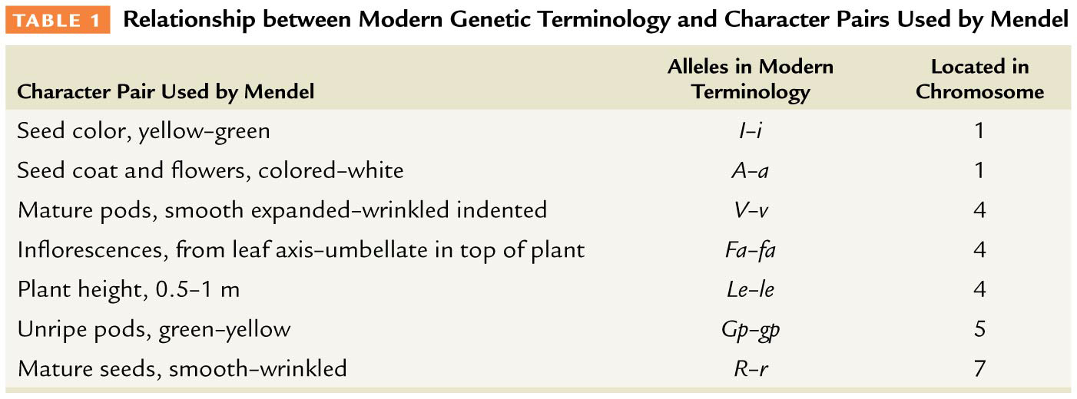
Table 5–1

Slide 15
Why did Mendel only describe independently assorting unit factors?!
  For the dihybrid crosses he studied only, those involving linked genes included genes that are so distantly linked on the chromosome that they appear unlinked (~50% recombination)

Slide 16
There are further limitations to recombination mapping
  Consider again, genes that are distantly spaced on the same chromosome. They are more likely to have more than one X.0. occur between them.

Slide 17
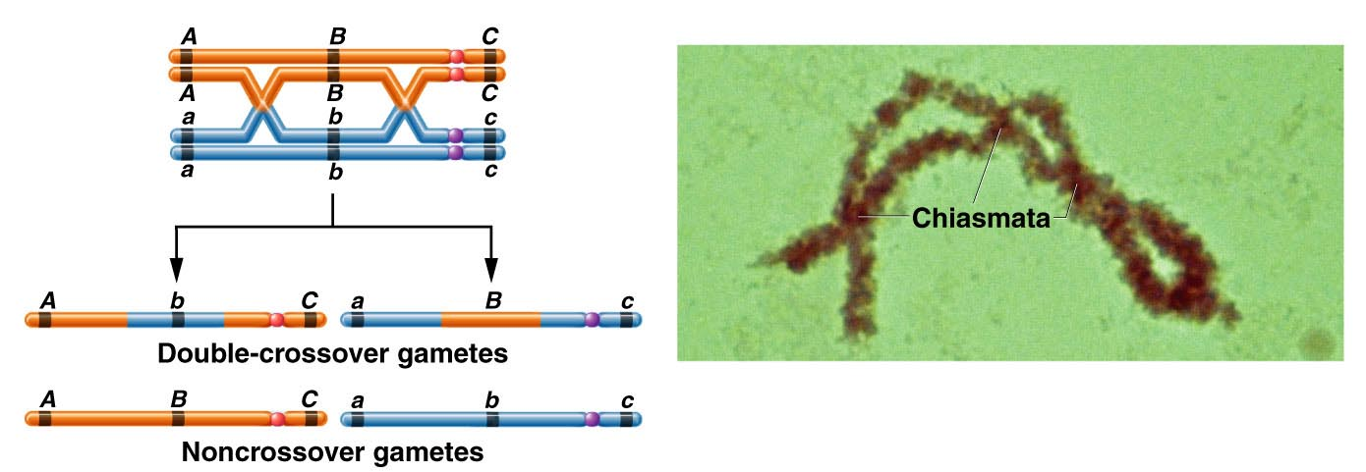
Figure 5.7ab
Notes:
Figure 5-7ab Consequences of a double exchange occurring between two nonsister chromatids. Because the exchanges involve only two chromatids, two noncrossover gametes and two double-crossover gametes are produced. The photograph illustrates several chiasmata found in a tetrad isolated during the first meiotic prophase stage.

Slide 18
Result can vary the observed recombination frequencies.

Slide 19
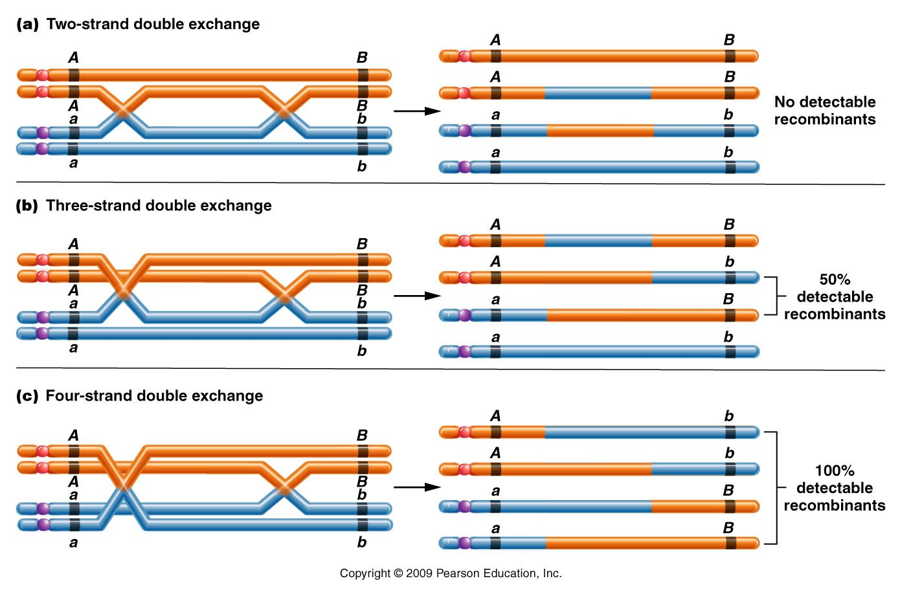
Observe 3 examples in which 2 XO occurred between A and B
Figure 5.12
Notes:
Figure 5-12 Three types of double exchanges that may occur between two genes. Two of them, (b) and (c), involve more than two chromatids. In each case, the detectable recombinant chromatids are bracketed.

Slide 20
So again we see that we may over- or underestimate the distance between 2 genes.
Bottom line…recombination mapping is most accurate for more closely spaced loci.
  However…multiple cross-overs help us in certain aspects of mapping----Putting genes in a linear order.

Slide 21
Recall…
Initially mapping required multiple, 2-point crosses. Then the 2-point crosses could be put together to make a map with gene order and distances.

Slide 22
Sturtevant noted that recombination frequencies were approximately additive, allowing the order of genes to be determined.
In 3 separate crosses:
  y-w frequency is 0.5%
  w-m frequency is 35.4
  y-m frequency is 34.5 %
**Which genes are on the outside? Which gene is in the middle?

Slide 23
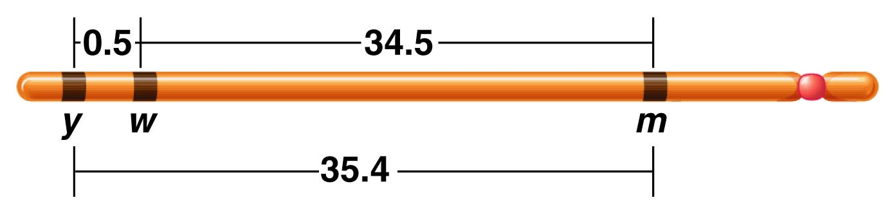
Figure 5.4
Notes:
Figure 5-4 A map of the yellow (y), white (w), and miniature (m) genes on the X chromosome of Drosophila melanogaster. Each number represents the percentage of recombinant offspring produced in one of three crosses, each involving two different genes.

Slide 24
Discovery that multiple X.O can occur between loci actually simplified chromosome mapping, allowing multiple loci to be mapped in a single cross.

Slide 25
Some background…
How are single and multiple X.O. related?…
  Crossover in any interval is related to the physical distance between loci.
c
a
b
7 cM
12 cM

Slide 26
c
a
b
7 cM
12 cM
The map was made by observing recombination frequencies.
a-b 0.07
b-c 0.12
What is the expected frequency of double crossover in the interval a-c?
(One X.O. in a-b and one X.O. in b-c)

Slide 27
Assuming X.O in one interval does not influence X.O. in the other interval we can use the product rule.
a-b (0.07) X b-c (0.12) =0.0084
  Frequency of double cross over (DCO) is only .84%

Slide 28
What would DCO look like in this map?
Sketch on board…

Slide 29
What would DCO look like in this map?
X
X
Sketch on board…

Slide 30
* Single crossover in A-B and B-C regions would be expected to be more frequent than DCO frequency.
Figure 5.7ab
Notes:
Figure 5-7ab Consequences of a double exchange occurring between two nonsister chromatids. Because the exchanges involve only two chromatids, two noncrossover gametes and two double-crossover gametes are produced. The photograph illustrates several chiasmata found in a tetrad isolated during the first meiotic prophase stage.

Slide 31
Knowing DCO occur much more rarely than SCO allows us to determine gene order in a multi-point cross.
Start with 3-point cross…

Slide 32
3 basic requirements for successful 3-point mapping
Organism doing the X.O/ recombination must be heterozygous for all loci under consideration

Slide 33
Cross design must allow for direct observation of crossing over in gametes as a phenotype in offspring.
  Usually the mate contributes only recessive alleles.

Slide 34
Sufficient numbers of offspring must be examined to recover a representative sample of all crossover classes.

Slide 35
Knowing the design of the cross, 3 types of offspring should be evident.
  Non-crossover (NCO). Offspring derived from gametes in which no crossover occurred in the interval of interest.
  Single-cross-over (SCO) Offspring derived from gametes in which crossover occurred in one of the 2 intergene regions. **2 different SCO are produced.
  Double cross-over (DCO) Offspring derived from gametes in which crossover occurred in both intergene regions of interest.

Slide 36
NCO (parental combinations) will be the most frequent—Although XO happens, it can happen anywhere along the chromosome. Not always in the interval you are analyzing.
DCO will be the least frequent
SCO 1
will show intermediate frequencies reflecting the intergene distances.
SCO 2

Slide 37
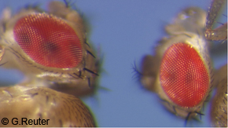
3 X-linked genes in example
w-white eyes
y-yellow body 3 recessive mutations
ec-echinus (eye shape)

Slide 38
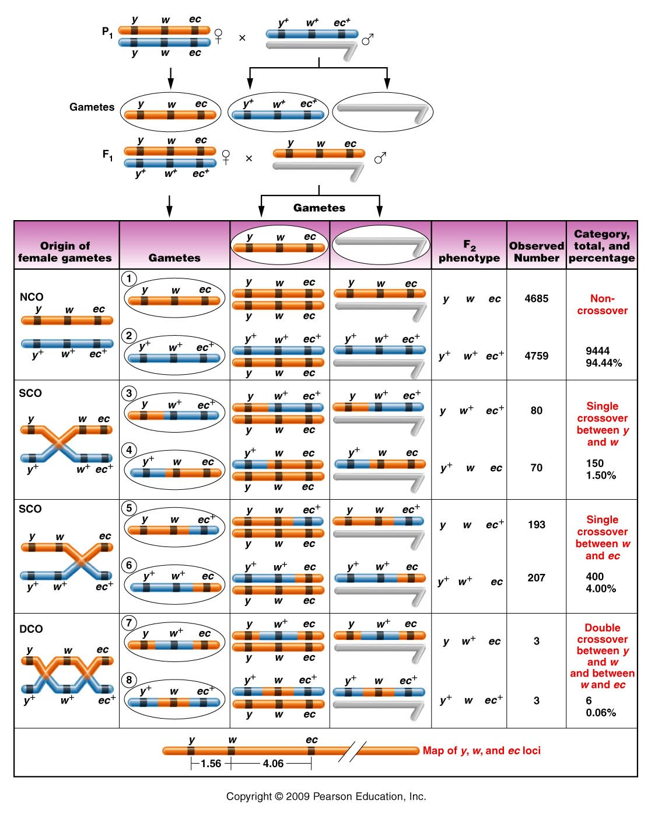
Cross is made to produce female heterozygote and completely recessive male.
Figure 5.8
Notes:
38
Figure 5-8 A three-point mapping cross involving the yellow (y or y⁺), white (w or w⁺), and echinus (ec or ec⁺) genes in Drosophila melanogaster. NCO, SCO, and DCO refer to noncrossover, single-crossover, and double-crossover groups, respectively. Centromeres are not drawn on the chromosomes, and only two nonsister chromatids are initially shown in the left-hand column.

Slide 39
Cross is made to produce female heterozygote and completely recessive male.
Figure 5.8
Notes:
39
Figure 5-8 A three-point mapping cross involving the yellow (y or y⁺), white (w or w⁺), and echinus (ec or ec⁺) genes in Drosophila melanogaster. NCO, SCO, and DCO refer to noncrossover, single-crossover, and double-crossover groups, respectively. Centromeres are not drawn on the chromosomes, and only two nonsister chromatids are initially shown in the left-hand column.

Slide 40
What are the possible orders for 3 genes?
y-ec-w (w-ec-y)
y-w-ec (ec-w-y)
w-y-ec (ec-y-w)

Slide 41
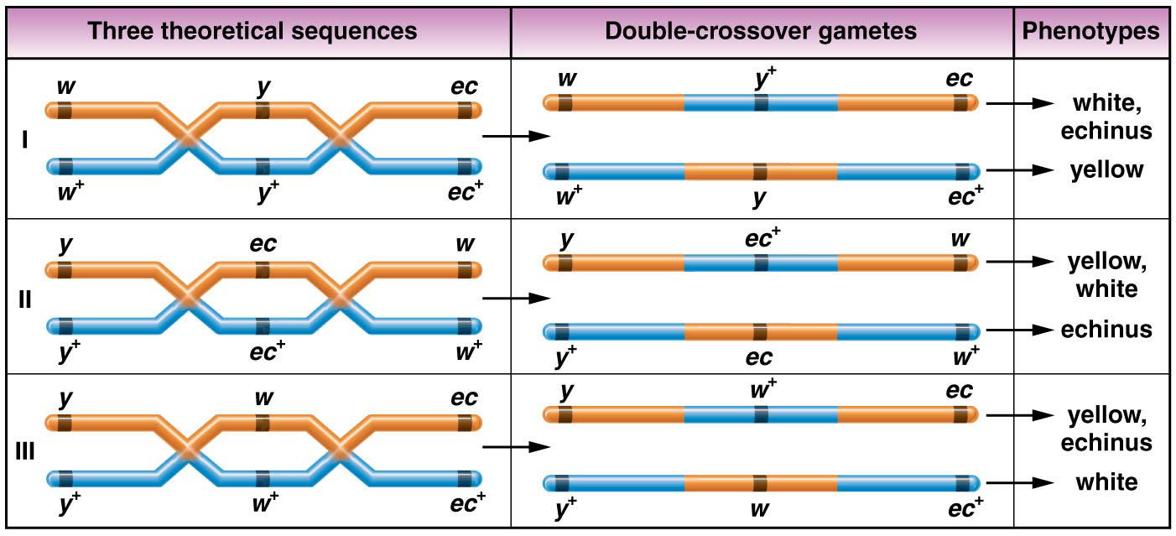
Figure 5–9 The three possible sequences of the white, yellow, and echinus genes, the results of a double crossover in each case, and the resulting phenotypes produced in a testcross.

Slide 42
Go back to the table, and identify how the genes would change to make DCO.
Play with the orders to turn NCO to DCO.
The order should be revealed.

Slide 43
Now sketch the cross (cross A) that we have set up with our flies and review how we will be able to map the X-linked genes, y, m, and w.

